Slide 1
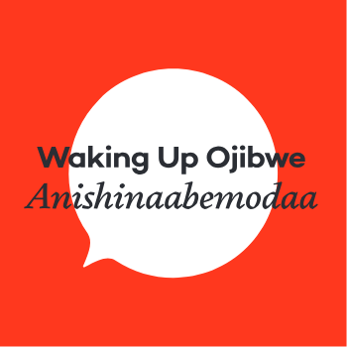
Miigwech
Expressing Gratitude & Using Grammar Patterns

Slide 2
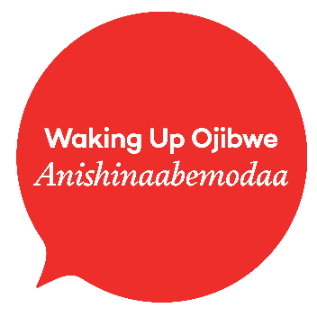
Noongom
Waa-izhichigeying
Waking Up Ojibwe Anishinaabemodaa
Introductions
Expressing Gratitude
vii & vai
vti & inanimate nouns
vta & animate nouns
Using the Patterns

Slide 3
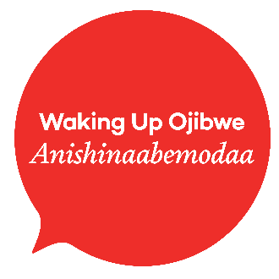
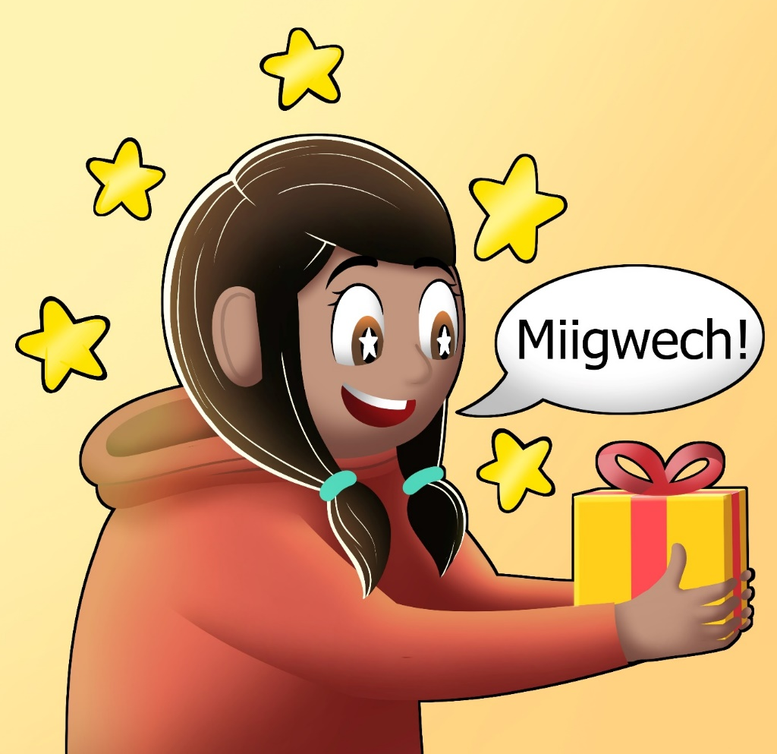
Why Gratitude is important
It is important for us to remember to express gratitude for everything. We can be thankful for waking up in the morning, for someone helping us, for food from the land, and so many other things.
The language around expressing gratitude can be simple or complicated. Today we will focus on the grammar patterns that allow us to express simple gratefulness.

Slide 4
Anishinaabemowin Verb Forms
vii
Verb Inanimate Intransitive
vai
Verb Animate Intransitive
vti
Verb Transitive Inanimate
vta
Verb Transitive Animate
miskwadite
miskwadiso
miskwadisin
miskwadis

Slide 5
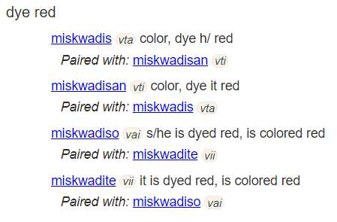
Using the Ojibwe People’s Dictionary
Go to https://ojibwe.lib.umn.edu/
Type in your word and select Search in Ojibwe or Search in English
Choose the needed verb based on the denotations in the gray circles

Slide 6
Verb inanimate intransitive & verb animate intransitive
vii & vai

Slide 7
vii
These types of verbs describe a state of being. They can relate to an object or an abstract notion. Some examples are:
gakakaa – it is square
gimiwan – it is raining
ozaawaa – it is yellow
zaagaate – it shines, sun comes up or out
dibikad – it is night
dakiigamin – it is cold (liquid)

Slide 8
vai
These types of verbs describe an action being done by someone. The main verb form is always in third person singular to start and has to be conjugated to change. Some examples are:
miigwechiwendam – s/he is thankful, grateful
bimose – s/he is walking
namadabi – s/he is sitting
giiyose – s/he is hunting

Slide 9
A Form conjugations of miigwechiwendam
nimiigwechiwendam – I am grateful
gimiigwechiwendam – you are grateful
miigwechiwendam – s/he is grateful
nimiigwechiwendaamin – we are grateful (not including the one spoken to)
gimiigwechiwendaamin – we are grateful (including the one spoken to)
gimiigwechiwendaam – you all are grateful
miigwechiwendamoog – they are grateful

Slide 10
A Form Yes/No Questions of miigwechiwendam
nimiigwechiwendam ina? – Am I grateful?
gimiigwechiwendam ina? – Are you grateful?
miigwechiwendam ina? – Is s/he grateful?
nimiigwechiwendaamin ina? – Are we grateful? (not including the one spoken to)
gimiigwechiwendaamin ina? – Are we grateful? (including the one spoken to)
gimiigwechiwendaam ina? – Are you all grateful?
miigwechiwendamoog ina? – Are they grateful?
Asking a yes/no question: Use ina when the preceding word ends in a consonant and use na when the preceding word ends in a vowel. You can only put ina/na in the second position of a sentence – it is always the second word.

Slide 11
A Form of miigwechiwendam with B Form vii
Aaniin dash wenji-miigwechiwendaman? – Why are you thankful?
Let’s express gratitude for different types of weather which are vii type verbs.
Pattern: Nimiigwechiwendam ___________g/k.
Nimiigwechiwendam gimiwang. Nimiigwechiwendam zoogipong. Nimiigwechiwendam awanibiisaamagak. Nimiigwechiwendam zaagaateg.

Slide 12
Gojitoon - try it
Gimiigwechiwendam ina? Are you grateful?
Nimiigwechiwendam. I am grateful.
Aaniin dash wenji-miigwechiwendaman? Why are you grateful?
Nimiigwechiwendam gii-kimiwang noongom. I am grateful that it was raining today.

Slide 13
A Form of miigwechiwendam with B Form vai
Aaniin dash wenji-miigwechiwendaman? – Why are you thankful?
Let’s express gratitude for different activities that we did today.
Pattern: Nimiigwechiwendam gii-___________yaan/aan.
Nimiigwechiwendam gii-koshkoziyaan. Nimiigwechiwendam gii-wiisiniyaan. Nimiigwechiwendam gii-anishinaabemoyaan. Nimiigwechiwendam gii-jiikendamaan.

Slide 14
Gojitoon - try it
Gimiigwechiwendam ina? Are you grateful?
Nimiigwechiwendam. I am grateful.
Aaniin dash wenji-miigwechiwendaman? Why are you grateful?
Nimiigwechiwendam gii-biijibizoyaan noongom. I am grateful that I drove here today.
Giin dash? Aaniin dash wenji-miigwechiwendaman noongom? And you? Why are you grateful today?

Slide 15
Verb transitive inanimate
vti

Slide 16
vti
These types of verbs describe an action someone is doing to something inanimate. The main verb has to be conjugated in order to know who is doing the action. Some examples are:
miigwechiwendan – be thankful, be grateful for it
mikan – find it
aabajitoon – use it
miijin – eat it

Slide 17
A Form conjugations of miigwechiwendan
nimiigwechiwendaan[an] – I am grateful for it [them]
gimiigwechiwendaan[an] – you are grateful for it [them]
omiigwechiwendaan[an] – s/he is grateful for it [them]
nimiigwechiwendaamin – we are grateful for it/them (not including the one spoken to)
gimiigwechiwendaamin – we are grateful for it/them (including the one spoken to)
gimiigwechiwendaanaawaa[n] – you all are grateful for it [them]
omiigwechiwendaanaawaa[n] – they are grateful for it [them]

Slide 18
A Form Yes/No Questions of miigwechiwendan
nimiigwechiwendaan[an] ina? – Am I grateful for it [them]?
gimiigwechiwendaan[an] ina? – Are you grateful for it [them]?
omiigwechiwendaan[an] ina? – Is s/he grateful?
nimiigwechiwendaamin ina? – Are we grateful for it/them? (not including the one spoken to)
gimiigwechiwendaamin ina? – Are we grateful for it/them? (including the one spoken to)
gimiigwechiwendaanaawaa[n] ina? – Are you all grateful for it [them]?
omiigwechiwendaanaawaa[n] ina? – Are they grateful for it [them]?
Asking a yes/no question: Use ina when the preceding word ends in a consonant and use na when the preceding word ends in a vowel. You can only put ina/na in the second position of a sentence – it is always the second word.

Slide 19
Anishinaabemowin NOUNS
Animate Nouns
Inanimate Nouns
Singular
Plural
Singular
Plural
ikwe
ikwewag
makak
makakoon

Slide 20
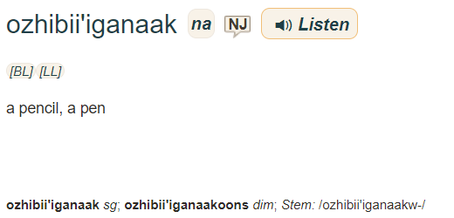
Use the Ojibwe People’s Dictionary
Go to https://ojibwe.lib.umn.edu/
Type in your word and select Search in Ojibwe or Search in English
Choose the needed noun based on the denotations in the gray circles
Border Lakes dialect indicator
This means it’s more likely to be used in our area!
sg - singular (one item)
pl - plural (more than one item)
dim - diminutive (small)
loc - locative (location)
Nancy Jones does a lot of recording for this dictionary and is great to listen to when her words are available!

Slide 21
More About Nouns
The animate/inanimate dichotomy was created by linguists to classify nouns in Anishinaabemowin. It does not mean something is alive/dead.
This dichotomy is not necessarily always reflective of Anishinaabe worldview. Learning this dichotomy allows us to understand how the nouns function with verbs.
Nouns can also be turned into diminutives, made smaller i.e. ikwe > ikwezens, makak > makakoons
Nouns can also be turned into locatives, made locations i.e. makak > makakong

Slide 22
A Form conjugations of miigwechiwendan with Inanimate Nouns (ni)
nimiigwechiwendaan nibi – I am grateful for water
gimiigwechiwendaanan ziinzibaakwadoonsan – you are grateful for candies
omiigwechiwendaan mino-bimaadiziwin – s/he is grateful for the good life
nimiigwechiwendaamin gaapii – we are grateful for coffee
gimiigwechiwendaamin miijim – we are grateful for food
gimiigwechiwendaanaawaan mazina’iganan – you all are grateful for books
omiigwechiwendaanaawaan waabigwaniin – they are grateful for flowers

Slide 23
A Form conjugations of miigwechiwendan with Inanimate Nouns (ni)
Wegonen dash miigwechiwendaman? – What are you grateful for?
Let’s express gratitude for different things we like. Remember they must be inanimate nouns (ni)
Pattern: Nimiigwechiwendaan ___________. (singular) Nimiigwechiwendaanan ___________. (plural)
Nimiigwechiwendaan nibi. Nimiigwechiwendaan miijim. Nimiigwechiwendaanan mazina’iganan.

Slide 24
Gojitoon - try it
Wegonen dash miigwechiwendaman? What are you grateful for?
Nimiigwechiwendaanan opiniin. Giin dash? I am grateful for potatoes. And you?
Switch out the word opiniin for something you are grateful for – be sure it is an inanimate noun (ni). Then ask someone else.

Slide 25
Verb transitive animate
vta

Slide 26
vta
These types of verbs describe an action being done by someone to someone or something that is animate. The main verb form is always in second to third person command form and has to be conjugated to change. Some examples are:
miigwechiwenim – be thankful for h/
amo – eat h/
bakite’ – hit h/
zhawenim – love h/

Slide 27
A Form conjugations of miigwechiwenim
gimiigwechiwenimin – I am grateful for you
gimiigwechiwenimininim – I am grateful for all of you
nimiigwechiwenimaa – I am grateful for h/
nimiigwechiwenimaag – I am grateful for them
omiigwechiwenimaan – S/he is grateful for h/ (3rd person>4th person/thing)
These are only a few of the many vta conjugations that we will focus on today.

Slide 28
A Form conjugations of miigwechiwenim with Animate Nouns (na)
gimiigwechiwenimin niijii – I am grateful for you my friend
gimiigwechiwenimininim nindinawemaaganag – I am grateful for all of you, my relatives
nimiigwechiwenimaa inday – I am grateful for my dog
nimiigwechiwenimaag anangoog – I am grateful for stars
omiigwechiwenimaan bakwezhigan – S/he is grateful for bannock

Slide 29
A Form conjugations of miigwechiwenim with Animate Nouns (na)
Wegonen dash miigwechiwenimad? – What are you grateful for?
Let’s express gratitude for different things we like. Remember they must be animate nouns (na)
Pattern: Nimiigwechiwenimaa ___________. (singular) Nimiigwechiwenimaag ___________. (plural)
Nimiigwechiwenimaa dibiki-giizis. Nimiigwechiwenimaag miskominag.

Slide 30
Gojitoon - try it
Wegonen dash miigwechiwenimad? What are you grateful for?
Nimiigwechiwenimaag anangoog. Giin dash? I am grateful for stars. And you?
Switch out the word anangoog for something you are grateful for – be sure it is an animate noun (ni). Then ask someone else.

Slide 31
A Form conjugations of miigwechiwenim with Animate Nouns (na)
Awenen miigwechiwenimad? – Who are you grateful for?
Let’s express gratitude for different people in our lives.
Pattern: Nimiigwechiwenimaa ___________. (singular) Nimiigwechiwenimaag ___________. (plural)
Nimiigwechiwenimaa nimaamaa. Nimiigwechiwenimaag nookomisag.

Slide 32
Gojitoon - try it
Awenen miigwechiwenimad? Who are you grateful for?
Nimiigwechiwenimaag nimishoomisag. Giin dash? I am grateful for my grandfathers. And you?
Switch out the word nimishoomisag for someone you are grateful for. Then ask someone else.

Slide 33
Using The Patterns
How to substitute your verbs to create more sentences!

Slide 34
Vii & vai Next step
The Pattern You Learned:
Change the verb:
Nimiigwechiwendam gimiwang. I am grateful that it’s raining.
Niminwendam gimiwang. I am happy when it’s raining.
Change the verb & the noun:
Niminwendam zoogipong. I am happy when it’s snowing.
Change the person:
Giminwendam zoogipong. You are happy when it’s snowing.

Slide 35
vai Next step
The Pattern You Learned:
Change the verb:
Nimiigwechiwendam gii-koshkoziyaan. I am grateful that I woke up.
Niminwendam gii-koshkoziyaan. I am happy that I woke up.
Change the verb & the noun:
Niminwendam gii-wiisiniyaan. I am happy that I ate.
Change the person:
Minwendamoog gii-wiisiniwaad. They are happy that they ate.

Slide 36
Vti Next step
The Pattern You Learned:
Change the verb:
Nimiigwechiwendaan nibi. I am grateful for water.
Niminwendaan nibi. I like water.
Change the verb & the noun:
Niwaabandaanan miinan. I see blueberries.
Change the person:
Owaabandaanan miinan. She sees blueberries.

Slide 37
Vta Next step
The Pattern You Learned:
Change the verb:
Nimiigwechiwenimaa nimaamaa. I am thankful for h/ my mother.
Ninzhawenimaa nimaamaa. I love h/ my mother.
Change the verb & the noun:
Niminwenimaa niwiijiiwaagan. I like h/ my partner.
Change the person:
Owaabamaan waawaashkeshi. She sees a deer.

Slide 38
Gagwejimishig! Ask Us!
If you have any questions about today’s session or any upcoming sessions you can visit our website
www.wakingupojibwe.ca www.anishinaabemodaa.ca
Or contact Niigaanigaabawiik
carissac@7generations.org
The recording of this session will be shared on our website and YouTube page in the near future. Miigwech bizindawiyeg!

